Slide 1
CAPSTONE PROJECT DOMAIN - REAL ESTATE
BY : SHREYA CHANDEKAR

Slide 2
PROBLEM STATEMENT
Your client is the city council of Boston, MA. The council shared with you the attached data set and a data dictionary. The Boston city council leadership is interested in understanding the drivers behind the value of houses in Boston and are looking for data-driven recommendations on how they can increase the value of housing.
506 Observations
14 Variables

Slide 3
VARIABLE DISCRIPTION
CRIM – per capita crime rate by town.
ZN – proportion of residential land zoned for lots over 25,000 sq. ft.
INDUS – proportion of non-retain business acres per town.
CHAS - Charles River dummy variable (= 1 if tract bounds river; 0 otherwise).
NOX – nitrogen oxides concentration (parts per 10 million).
RM – average number of rooms per dwelling.
AGE – proportion of owner-occupied units built prior to 1940.
DIS – weighted mean of distances to five Boston employment centers.
RAD – index of accessibility to radial highways
TAX – full-value property-tax rate per $10,000
PTRATIO – pupil-teacher ratio by town
BLACK - 1000(Bk – 0.63)^2, where Bk is the proportion of blacks by town.
LSTAT – % lower status of the population.
MEDV – median value of owner-occupied homes in $1000.

Slide 4
Dependent variable is MEDV (median value of owner-occupied homes in $1000.) Independent variables is CRIM, ZN, INDUS, CHAS, NOX, RM, AGE, DIS, RAD, TAX, PTRATIO, B, LSTAT Multiple Linear Regression is used to find the fit a regression model that best explains the variation in MEDV. And factor that are influence the value of housing.

Slide 5
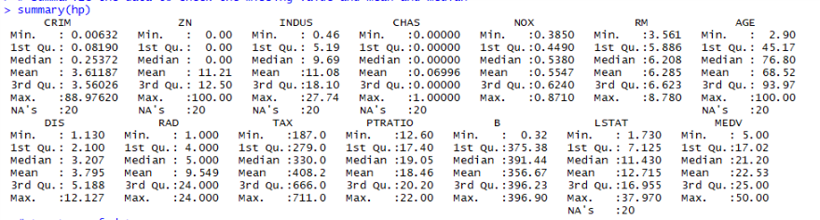
# Summarize the data to check the missing value and mean and median > summary(hp)
CRIM, ZN, INDUS, CHAS, AGE, LSTAT have 20 missing values

Slide 6
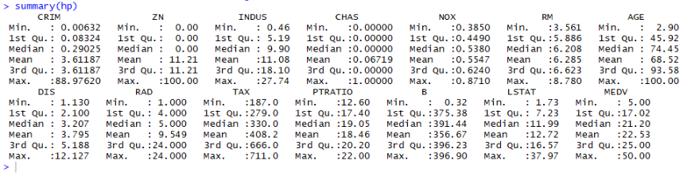
To treat the missing values, replace all the missing values CRIM, ZN, INDUS, CHAS, AGE, LSTAT with mean of respective variables. > summary(hp)
Summary of data after treating missing values.

Slide 7
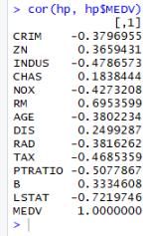
# Check the correlation between the dependent variable i.e. MEDV and the independent variables > cor(hp, hp$MEDV)
From correlation function, we can say that RM, PTRATIO, LSTAT, TAX are highly correlated to the target variable MEDV
RM(average number of group per dwelling) has the highest positive correlation.
PTRATIO(pupil-teacher ratio by town) and LSTAT (% lower status of the population) have the highest negative correlations.

Slide 8
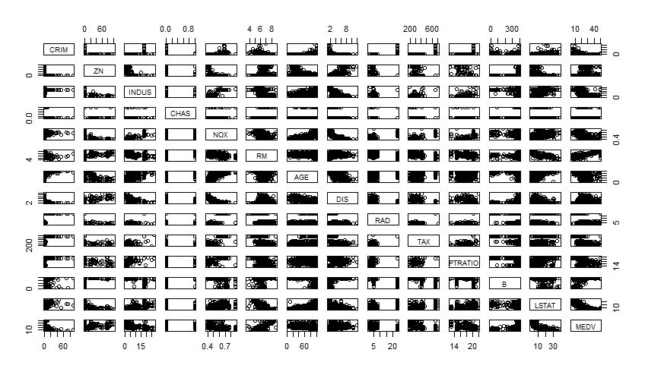
To examine the data to understand how it is distributed > plot(hp)

Slide 9
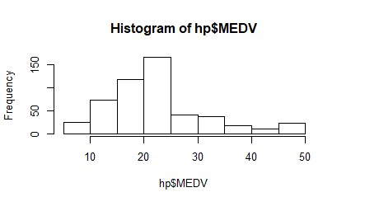
# Plot the histogram for the dependent variable to check the distribution of MEDV > hist(hp$MEDV)
The plot of MEDV is approx. normally distributed.

Slide 10
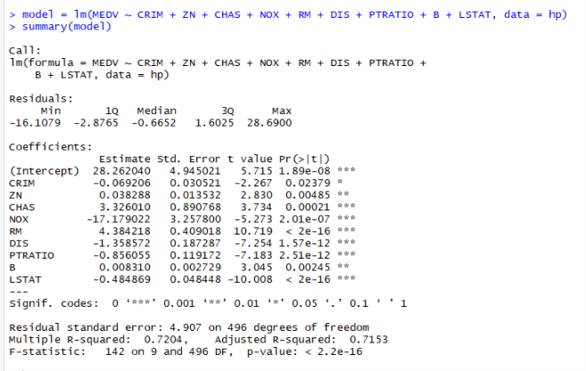
Model Building before removing outliers > model = lm(MEDV ~ CRIM + ZN + CHAS + NOX + RM + DIS + PTRATIO + B + LSTAT, data = hp)
After removed insignificant value,
Multiple R-Squared : 72.04%
Adj. R-Squared : 71.53%

Slide 11
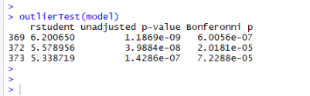
Check for outliers using outlierTest() function > outlierTest(model)
From outlier test, found out that there are 4 outliers
Remove 3 outliers from the data by
hp = hp[-c(366, 369, 372, 373), ]

Slide 12
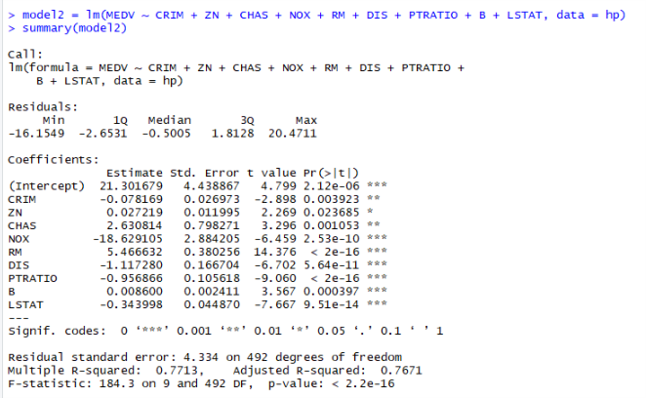
Rebuilding the model > model2 = lm(MEDV ~ CRIM + ZN + CHAS + NOX + RM + DIS + PTRATIO + B + LSTAT, data = hp) > summary(model2)
After remodelling,
Multiple R-Square : 77.13%
Adj. R-Square : 76.71%

Slide 13
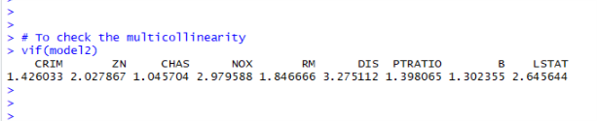
Compute the variation inflation factor(vif) to check multicollinearity > library(car) > vif(model)
To check the multicollinearity, vif<5. since all the variable have less than 5, then
conclude there is no multicollinearity between the independent variables

Slide 14
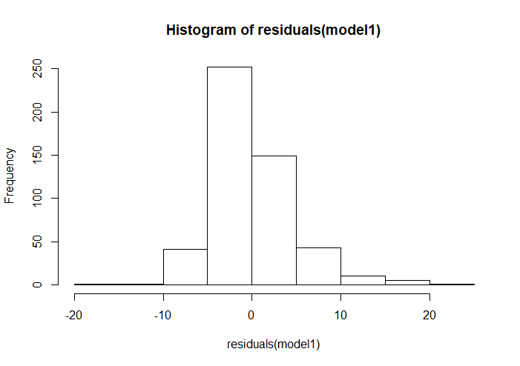
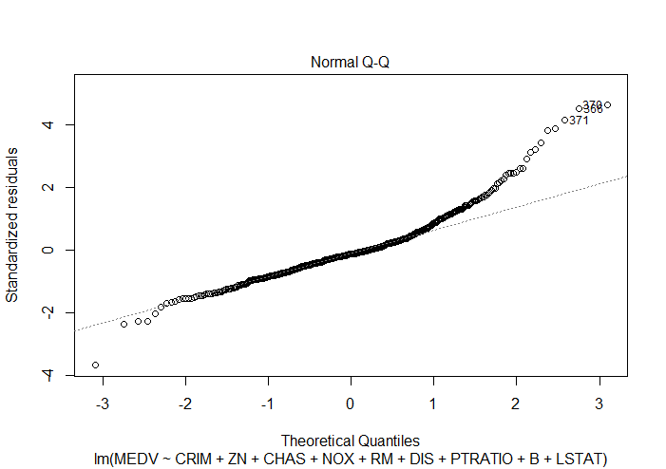
Residual Diagnostics Histogram of Residuals Normal Q-Q plot > hist(residuals(model2)) > qqnorm(residuals(model2))
Residuals appear to be approx. normally distributed.

Slide 15
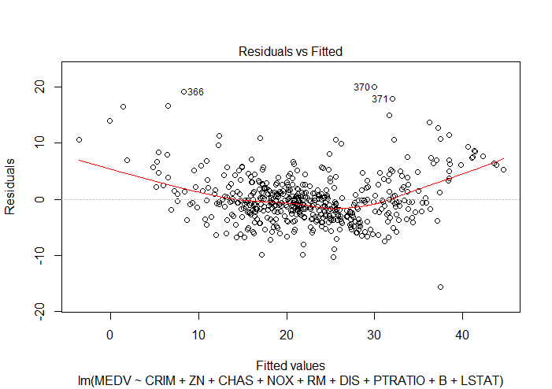
Checking for constant variance using Residuals vs Fitted plot > plot(model2)
The constant variance assumption appears to be satisfied. Removing the outliers and insignificant predictors definitely improved the model.

Slide 16
Conclusion Factors behind the value of housing is MEDV = 21.30 – 0.078*CRIM + 0.027*ZN + 2.63*CHAS – 18.62*NOX 5.47*RM – 1.12*DIS – 0.96*PTRATIO + 0.008*B – 0.34*LSTAT From the model, it can be interpreted that the average number of rooms is positively correlated with house price. There is also a positive correlation with Charles River. It is reasonable that more people would want to live closer to the river for the great view on offer and that this should raise the house prices. Similarly, there is negative correlations with crime rate, pupil-teacher ratios, Boston employment center and lower status of population are also to be expected. People would prefer to live in areas that have less crime and low pupil-teacher ratio where there is low population. People also prefer to live where there is less level of nitrogen oxide and want to live close to their employment place. An increased demand for houses in such areas would drive house prices up based on those factors.

